Slide 1





Movie Recommendation System – Data Analysis for RSVP Movies
by praveen yarramalla

Slide 2


Problem Statement
RSVP Movies has provided data on past movie releases over the last three years to help guide their decision-making process for an upcoming movie release aimed at a global audience. The analysis of this dataset is critical to identify patterns, trends, and key factors that can influence the success of their new global movie.

Slide 3



Analysis Agenda
In the analysis ,I worked with IMBD dataset to gain insights into Gross Income Performance , duriation insight popular genre etc.. key factors that impact the movie recommendation , i used SQL to queru and analyze the data as well as answer specific question about the datset.

Slide 4


Contents
Problem Statement
1
Analysis agenda
2
Data details
3
4
Key findings

Slide 5


Data set Details
The dataset contains the following tables:
movie – Contains details such as the title, release year, date published, duration, country, worldwide gross income, languages, and production company.
names – Likely contains information about actors, directors, or other personnel involved in the movies.
ratings – Contains user ratings and reviews of the movies.
role_mapping – Maps different personnel to their roles in the movie production process (e.g., actors, directors).
genre – Contains information about the genres associated with the movies.
director_mapping – Contains mapping details for directors assigned to movies.

Slide 6

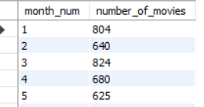
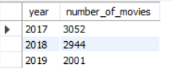
Yearly Movie Release Trends:
The SQL script analyzes movie releases by year to determine production trends.
Key Insight: The frequency of movie releases fluctuates, possibly due to market conditions or other external factors, helping identify optimal release times.

Slide 7


Popular genre analysis
A genre-based analysis of the movie database reveals which genres are most frequently produced and perform well.
Key Insight: Certain genres, such as action, comedy, and drama, dominate the market, suggesting a focus on these genres for future releases.
Popular genre analysis

Slide 8

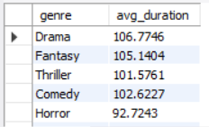
Duration insight
An analysis of movie duration highlights which runtimes are most common among high-grossing films.
Key Insight: Movies with a duration between 120–150 minutes tend to perform better, offering guidance on optimal runtime for future productions.

Slide 9

Gross income performance
The script examines the worldwide_gross_income to understand which movies were the most financially successful.
Key Insight: Identifying movies with the highest box office revenues can help understand the elements of successful films (e.g., star power, budget, release timing).

Slide 10

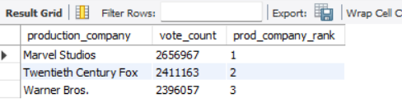
Language Distribution:
An analysis of the languages field highlights the importance of multilingual releases or subtitling to reach global audiences.
Key Insight: Offering movies in multiple languages increases their accessibility and can significantly boost international appeal.

Slide 11

Thank you

